Slide 1
COMPARATIVE ANALYSIS OF THE TURKISH PRESIDENTIAL SYSTEM WITH GOVERNMENT SYSTEMS INCLUDING SEPARATION OF POWER

Slide 2
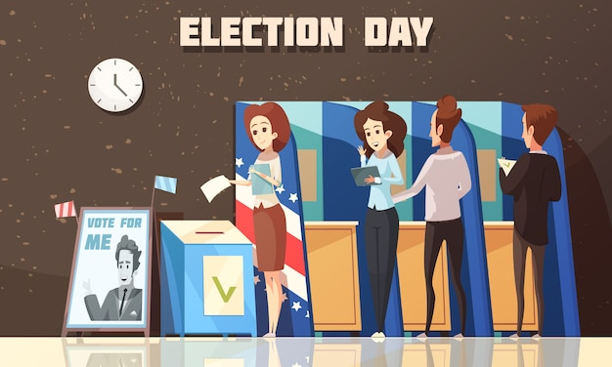
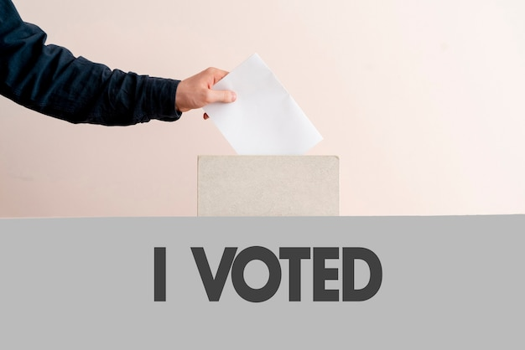
INTRODUCTION
Government system debates on the Turkish agenda are usually on the axis of the presidential system.

Slide 3
THE UNITY OF POWER – THE SEPARATION OF POWERS DICHOTOMY
Government systems can be defined as the entirety of the sequence of rules and institutions applied in constitutional democracies and non-democratic regimes in terms of the formation, distribution and regulation of legislative and executive powers within the state.

Slide 4
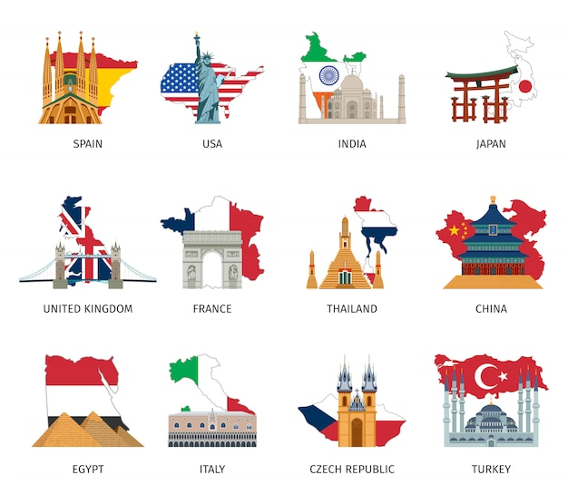
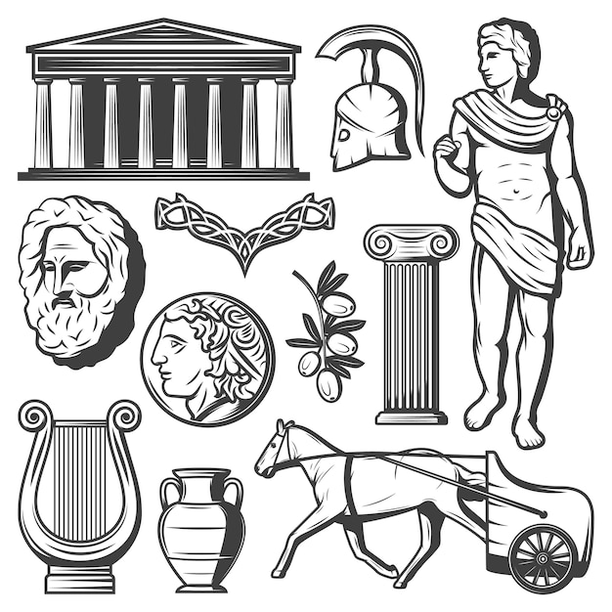
Thomas Hobbes is one of the foremost advocates of the unity of power in the history of political thought.
One of the most important discussions in the politics and the constitutional law literacy is the extents of the legislative and the executive powers in the relation to each other and how to establish them in government system and structures.

Slide 5
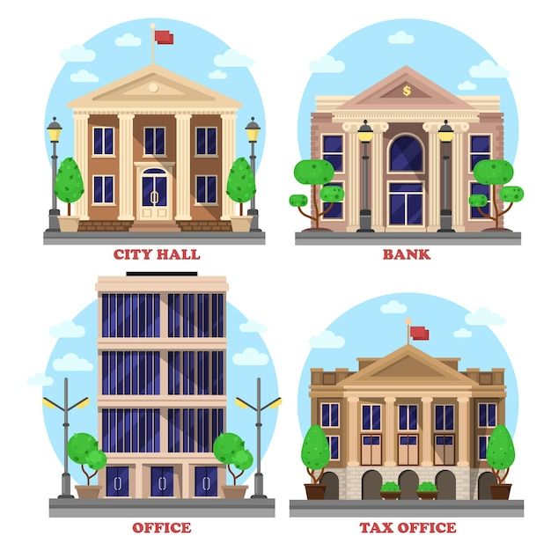
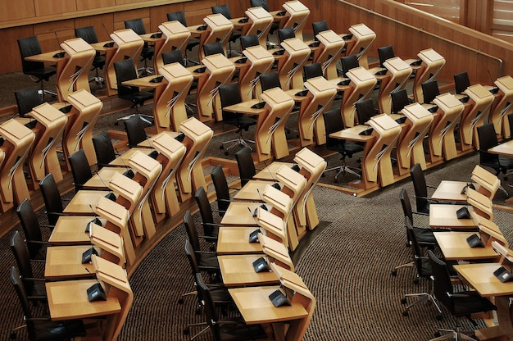
According to Maurice Duverger, the most prominent feature of democracies is their efforts to strengthen the legislative organ against the executive power.
In the historical process, the excessive development of parliament’s superiority prevented the executive power from taking measures to solve important problems, eventually resulting in severe violence.

Slide 6
THE GOVERNMENT SYSTEMS BASED ON THE SEPARATION OF POWERS: THE PRESIDENTIAL SYSTEM AND THE PARLIAMENTARY SYSTEM DICHOTOMY
While the governmental systems based on “the unity of power” can emerge as an “absolute monarchy” or “dictatorship” by combining legislative and executive powers in the executive organ.

Slide 7
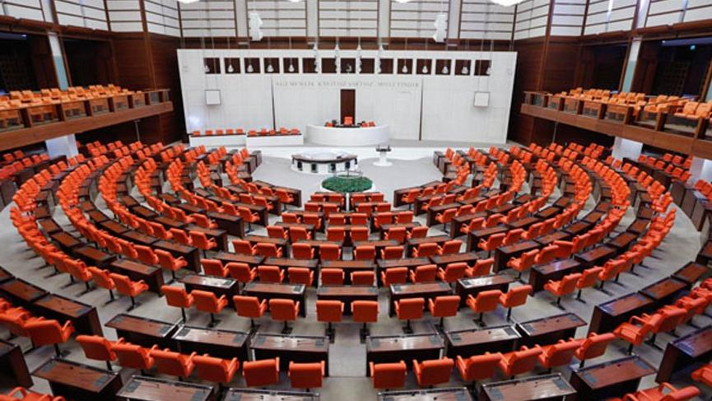
In “the parliamentary system”, the powers are divided in a soft and balanced manner, as the executive comes out of the legislative and these two organs can defeat each other’s legal assets through mechanisms such as “interpellation” or “dissolving parliament”.
The parliamentary system is the result of political evolution in England in the 18th century.

Slide 8
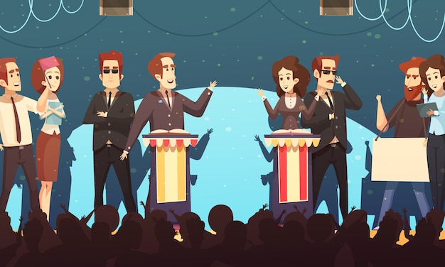
The political irresponsibility of the President in the parliamentary system also means that the executive organ has two heads. On the one hand, the President is both the head of executive organ, and the representative of the unity of the state and the integrity of the country.
In the contemporary constitutions, it seems that the prime minister has been granted more powers than the other ministers.
The presidential system is a model of the state administration born and implemented in the USA.
The presidential system can be defined as the President is head of the state and executive and he/she cannot be dismissed by legislative, he/she also has not authority of terminate the legislative organ.

Slide 9
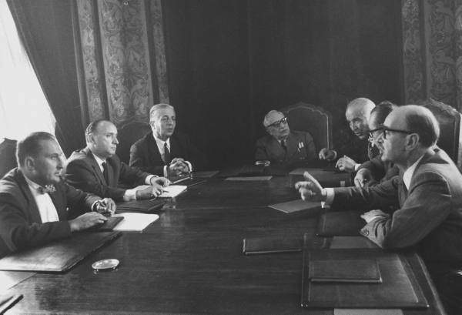
In the presidential system, which is also defined by the rigid separation of powers, the principle of independence is valid to come into and functioning of the legislative and the executive organs.
Moreover, in the presidential system, the President, representing a single executive organ and receives legitimacy from public directly or quasi directly via elections, and President remains in office for a determined period of time.
As a consequence of the singularity, the President is head of the state and the representative of all people, as well as an open partisan and political alternative, headed by the head of government (Gül, 2011: 595).

Slide 10
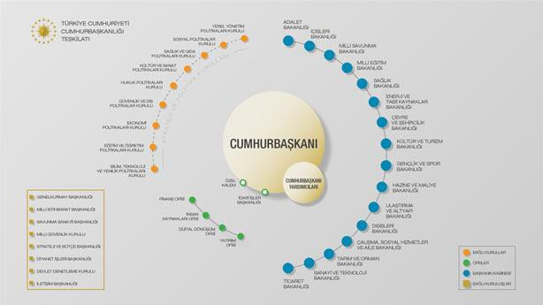
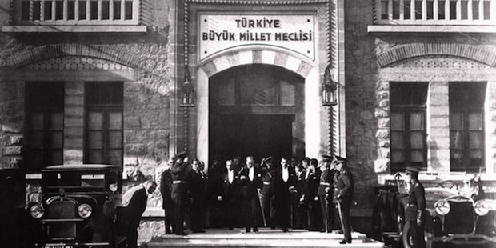
All these facts show that the presidential system has some strengths and weaknesses like other systems.
To sum up, the precondition for the separation of powers must be established in order for a debate to take place within the framework of the parliamentary system-presidential system dichotomy.

Slide 11
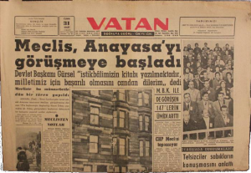
THE ADOPTION IN THE REFERENDUM ON APRIL 16, THE TURKISH PRESIDENTIAL GOVERNMENT MODEL
The government system in Turkey has been under the discussion since the 1961 Constitution, which foresees the soft separation of powers, has entered into force.
The reform demands, brought to the agenda by a number of politicians for various reasons, are often discussed on the axis of the presidential system.

Slide 12
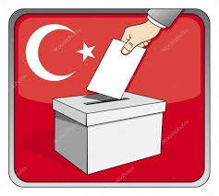
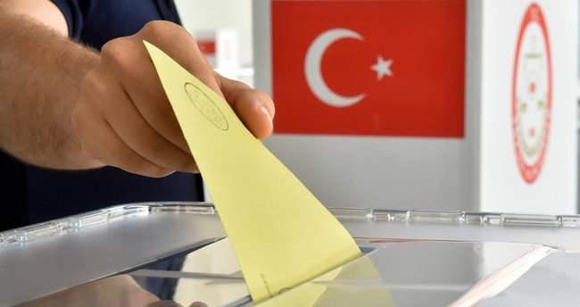
The year of 2012 is a turning point for the debates on the presidential system, which has been on the agenda for some time by some politicians over the last forty years.
The draft presented to the commission on November 2012 even though it is not legislated has a great importance with regard to the transfer of government systems to the agenda of Turkey.

Slide 13
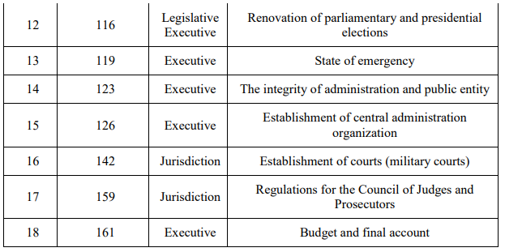

Slide 14
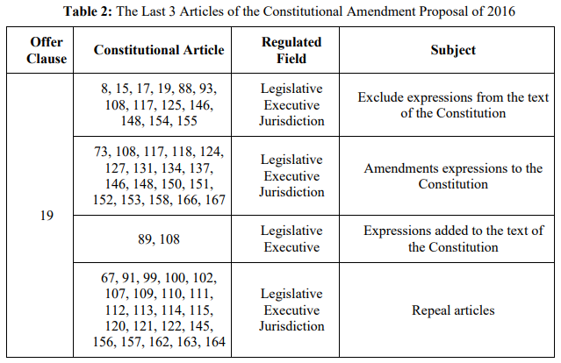
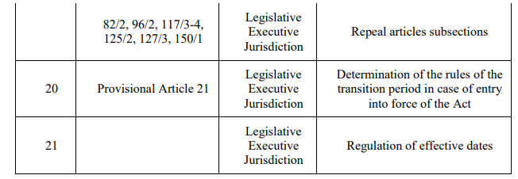

Slide 15
THE PLACE OF THE PRESIDENTIAL SYSTEM IN THE CONTEXT OF THE LEGISLATIVE ORGAN AND THE EXECUTIVE ORGAN RELATIONS BETWEEN THE GOVERNMENT SYSTEMS BASED ON THE SEPARATION OF POWERS
The text of the constitutional amendment, which leads to a change in a total of 69 articles of the Constitution, does not include a directive to the separation of powers or the unity of power.
On the other hand, the opening of the President to be a political party member, the understanding of the dominant leader in Turkish political culture and the dominance of chairman in the political parties, has the potential to damage separation of powers.

Slide 16
For example, Can (2016) states that only the executive-centered model of government has been introduced, in which the possibilities that the parliament can check and balance with the presidential system have been abolished.
In terms of the politics and the constitutional law literature, the main features of the presidential system and the parliamentary system are generally characterized as shown in Table 3.
In consideration of these features, the TPGM can be regarded as a presidential system in the context of its inability to participate in legislative activities and elections and the structure of the executive organ.
The fact that the term of abolition does not devolve in the text of the constitution and its inclusion in the text on the name of renewal of elections does not change the fact that both organs can terminate each other’s duties.

Slide 17
→ Gözler (2016) states that the proposed model is not a presidential system in terms of the legislative-executive relations, the system is similar to the parliamentary government system and the fact that the executive is single headed cannot meet the rigid separation of the legislative and the executive, and the system revealed by this action can be called as “parliamentary system without the Prime Minister”.

Slide 18
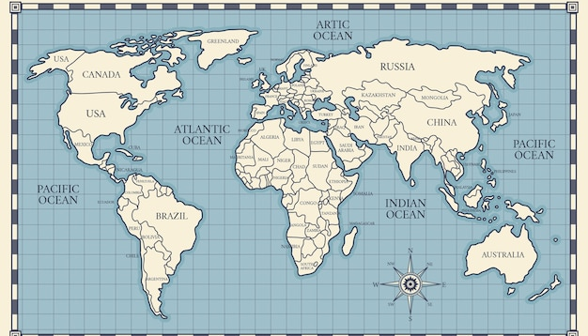
There is no presidential model other than the USA model in fact in the world. Examples are South America. But those countries do not have presidential typology in North America. What did he do? You are looking at the Constitutions, “the President abolishes parliament if the following conditions are met”; it’s destruction.
In sum, one of the main features of the presidential system is that the duty term of the legislative and the executive are fixed. In other words, these powers cannot put an end to each other’s duties. However, in the text of the constitutional amendment, it is stated that the powers can abolish each other’s duty term. From this point of view, the TPGM resembles parliamentary system rather than presidential system because of this specific feature.

Slide 19
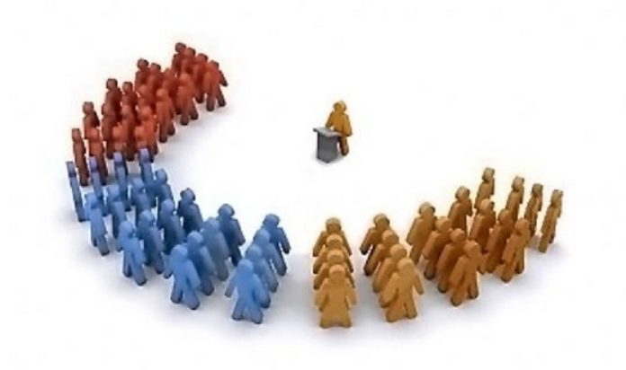
CONCLUSION
When the new model of government is examined within the framework of the separation of powers-unity of power dichotomies, it should be said that it is a system of government based on separation of powers technically.
When the TPGM is examined within the framework of the parliamentary systempresidential system dichotomy, it appears that the executive has the features of the presidential system from the standpoint of being single headed, elected by the public, out of the legislative, and cannot participate in the work of the legislative.
Consequently, the TPGM has introduced a unique system that has not been tested and has never been encountered in other societies. Although in the public opinion is lanced as a presidential system based on the separation of powers, both the separation of powers-unity of power and the position in the presidential system-parliamentary system dichotomies are ambiguous.

