Slide 1
CHAPTER 2: SYSTEM OF LAW
Dr. Fatih SERBEST

Slide 3
LEGAL SYSTEMS
«A legal system is an operating set of legal institutions, procedures and rules.»

Slide 4
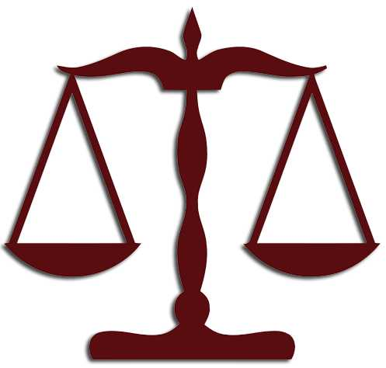
1. Common Law
2. Civil Law
3. Religious Law

Slide 5
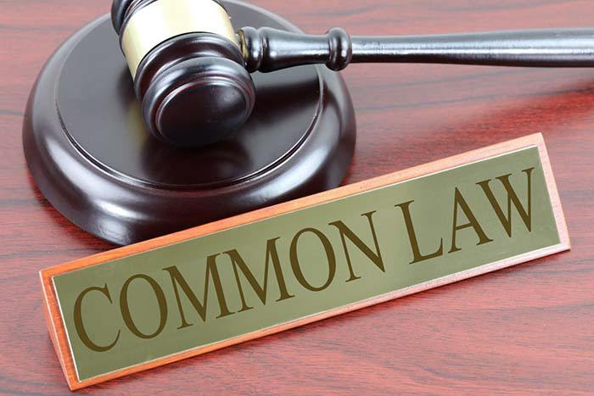
1.1. Common Law System
Common law is the expression comes from jus commune and refers to all those experiences that have their roots in medieval and modern English law.

Slide 6
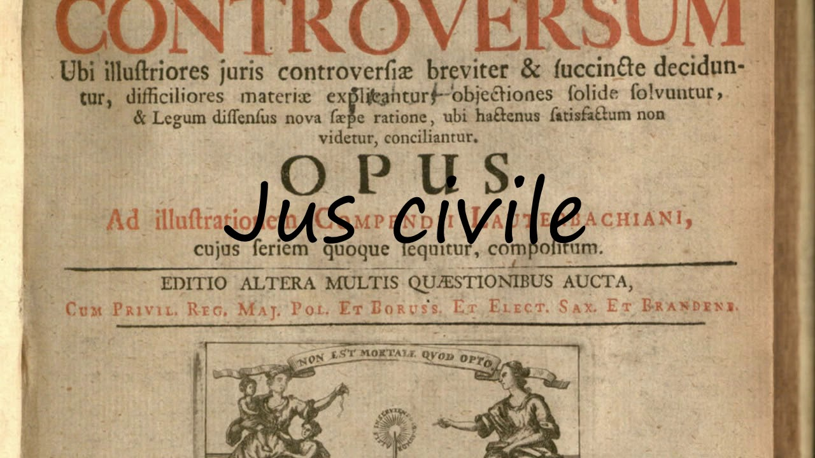
1.2. Civil Law Systems
Civil law is the expression comes from jus civile and refers to all those experiences that from a historical viewpoint have their roots in medieval continental Europe.

Slide 7
1.2.1 Common between Common Law and Civil Law

Slide 8
1.3 Religious Law System
Canon Law
Jewish Law
Hindu Law
Islamic Law

Slide 9
2. SEVERAL CONCEPTS 2.1. Law & Justice
"means legality; it is 'just' for a general rule to be actually applied in all cases where, according to its content, the rule should be applied. It is 'unjust' for it to be applied in one case and not in another similar case"

Slide 10
2.2 Legal Positivism & Natural Law
Natural law may be classified as follows:
1) Natural law based on the philosophy of nature.
2) Natural law based on the philosophy of religion.
3) Natural law based on human reason.

Slide 11
2.3. Domestic Law & International Law

Slide 12
2.3.1. Dualism

Slide 13
2.3.2 Monism

Slide 14
2.4. Substantive Law & Procedural Law

