Slide 1
CHAPTER 4: BRANCHES OF LAW
Please see the link below for the vıdeo lınk of the lecture
https://1drv.ms/v/s!AgK7oU6cEvEet1W357_JhCW_Bgzu?e=GaQv9z

Slide 2


PUBLIC LAW
PRIVATE LAW

Slide 3
«Public law is the law that concerns the position of Roman state; private law is the law that concerns the interest of the individual citizens.»
  ULPIAN, Roman Scholar

Slide 4
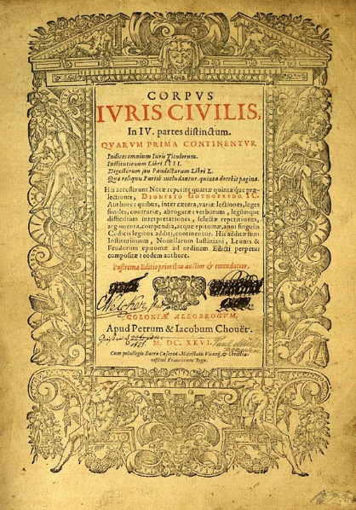
I. CORPUS IURIS CIVILIS
The Corpus Iuris Civilis in indispensable for Roman law research.

Slide 5

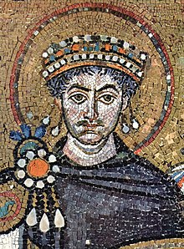
Justinian, Flavius Petrus Sabbatius, was not the first figure in Roman history to attempt to compile the Empire's law in one collection.

Slide 6

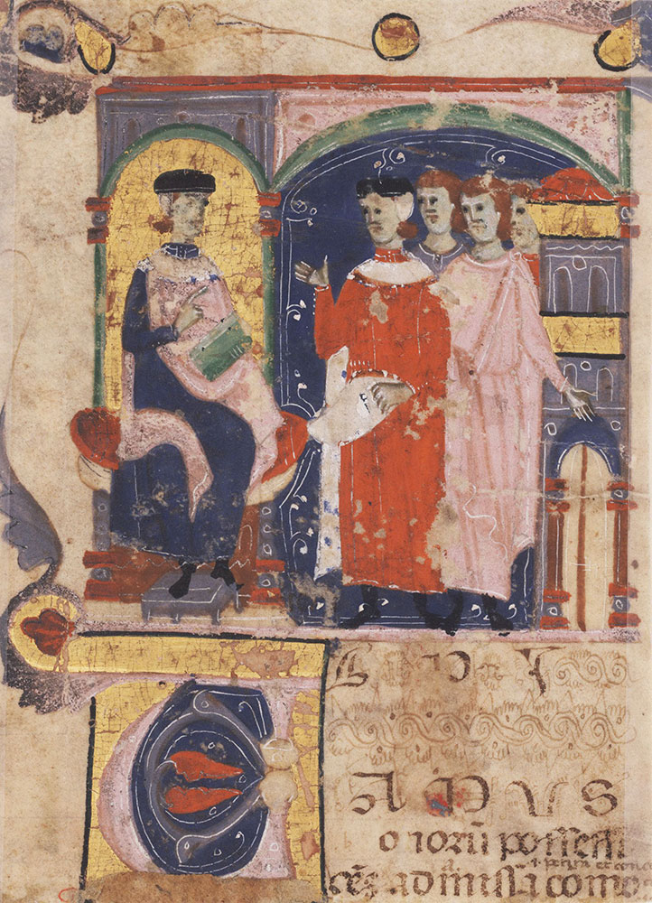

Slide 7
II. CRITERIA FOR THE DIVISON OF PUBLIC-PRIVATE LAW
Benefit Criterion
Free Will Criterion
Sovereigenty Criterion
Equality Criterion

Slide 8

2.1 Benefit Criterion
As can be seen in Ulpian's definition, in drawing a line between the two main branches of Law, the Romans focused their attention to the character interest protected by law.

Slide 9

2.2 Free Will Criterion
According to this criterion, the distinguishing feature between public and private law is not the character of the interest anymore, but rather the will of the parties involved in a given legal relation.

Slide 10

2.3 Sovereignty Criterion

Slide 11

2.4 Equality Criterion
In private law, the accession of the contracting parties has equal powers.
Public-private law distinction may be useful for both theoretical i.e., in achieving systematic knowledge and for practical purposes.

