Slide 1
CHAPTER 3: APPLICATION OF LEGAL RULES
PURPOSE OF THIS CHAPTER:
- What are the methods of reasoning?
- Who must prove the facts?
- What does presumption mean?
- How can you interpret legal rules?

Slide 2
1. Application of Legal Rules
Application entails the resolution of an actual conflict or controversy in light of these general abstract rules. This is a mental process that requires certain techniques and procedures.

Slide 3
1.1 Ascertaining the Applicable Rules
The first stage is to ascertain the applicable general and abstract rule. Legal rules in force at a given time may be various forms such as laws, regulations, by-laws, customs, etc.

Slide 4
1.2 Determining Facts
All legal cases must be based on certain facts. However, these are not needed to be proven :
* Facts commonly known
* Facts known to the organ ex officio
* Facts acknowledged by the other party

Slide 5
1.3 Applying the Relevant Provisions of Rule
The court reaches the legal conclusion by applying the relevant provisions of law and taking into consideration, arguments and counter-arguments made by the parties in the light of the relevant facts and legal rules. There are some methods employed by the court in reaching their judgment.

Slide 6
1.3.1 Syllogism
1.3.2 Argumentum a Contrario
1.3.3 Analogy (Argumentum a pari)

Slide 7
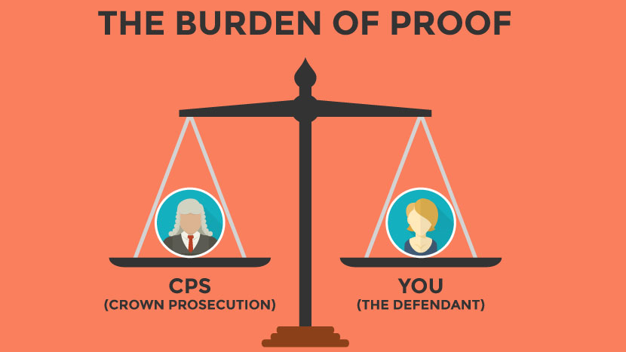
2. BURDEN OF PROOF AND PRESUMPTIONS

Slide 8
2.1 Burden of Proof
The rule is very simple: The facts alleged should be proven. However, who will prove first the alleged facts?

Slide 9
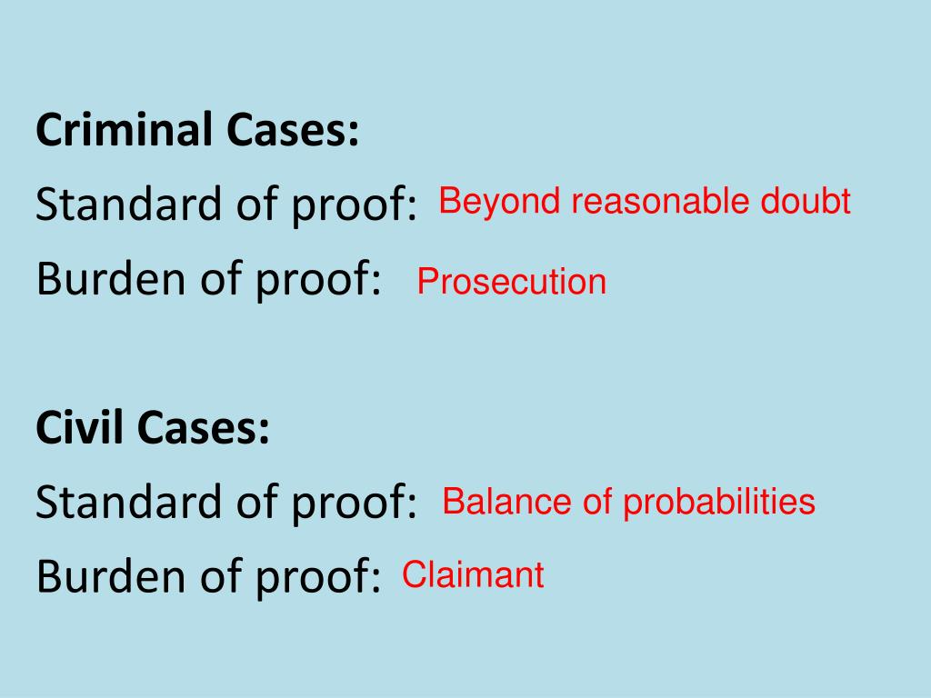
2.1.1 Burden of Proof in Criminal Cases
In criminal cases, all of the elements of crime with which the defendant is charged must be proven by the prosecutor.
2.1.2 Burden of Proof in Civil Cases
The burden of proof may shift from one party to another and claims and counter claims may go back and forth between parties.

Slide 10
2.2 Presumptions
Presumptions are very important because they are effective procedural devices for shifting the burden of proof.

Slide 11
2.2.1. Statutory Presumption
2.2.2. Rebuttable Presumption
2.2.3. Irrebuttable Presumption

Slide 12
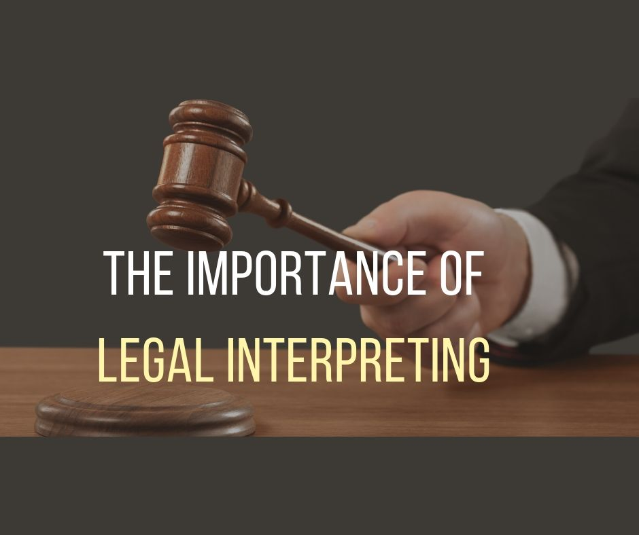
3.
INTERPRETATION
OF LEGAL RULES

Slide 13
Before explaining the methods of interpretation, we need to answer this question: Why do we need to interpret legal rules?

Slide 14
3.1 Textual Interpretation
3.2. Historical Interpretation
3.3. Logical Interpretation
3.4. Teleological Interpretation
3.5. Unrestricted Interpretation

